Slide 1
1021作業

Slide 2

part3

Slide 3
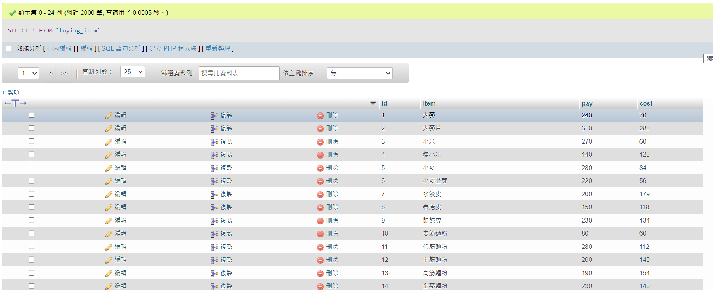

Slide 4
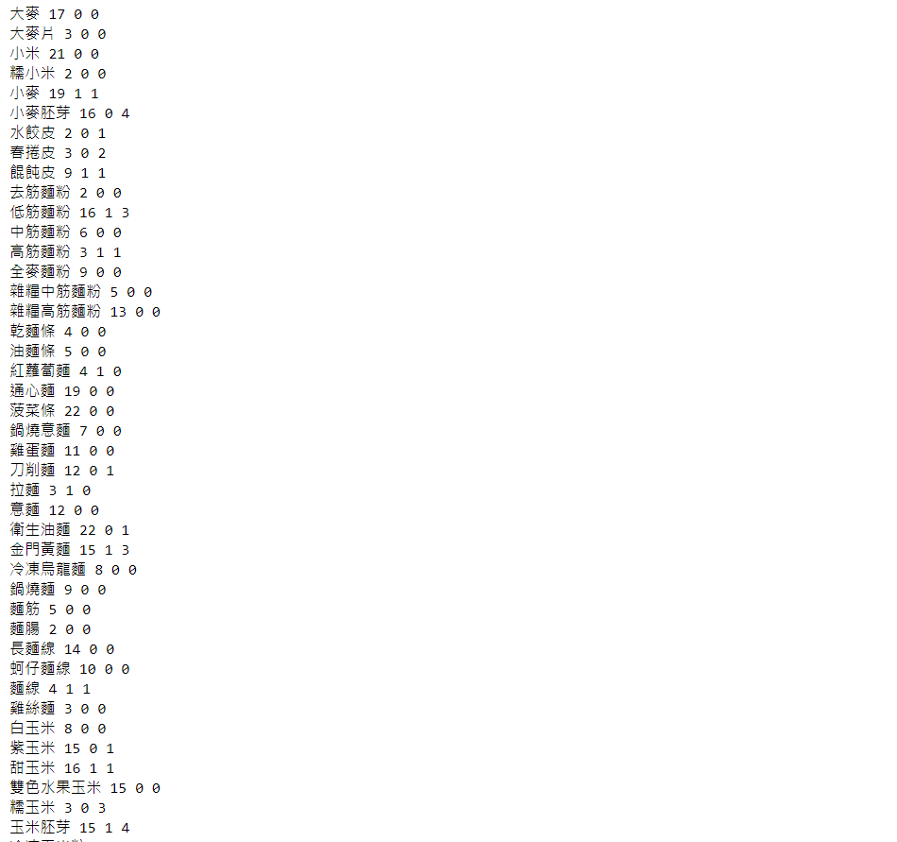
part4

Slide 5
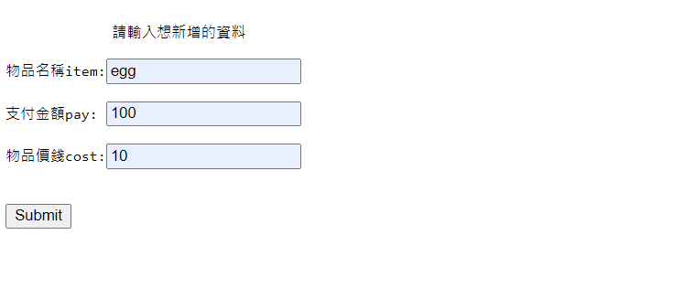
part5

Slide 6

